Slide 1

“Goff Patterns” Singleton Composite Observer
Presented by:
Shffan Maqsood
Umair Athar Saeed
Amir Sohail

Slide 2
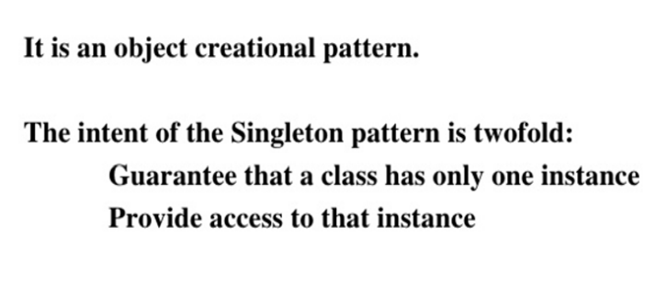
Singleton Pattern

Slide 3
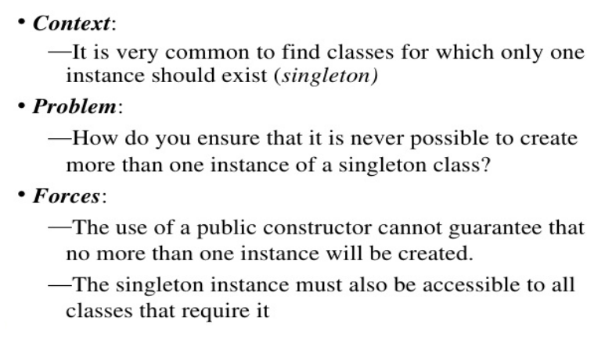
Singleton Pattern

Slide 4
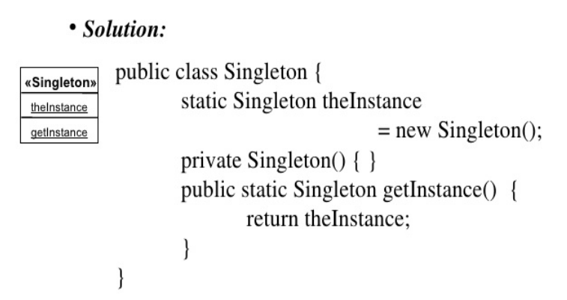
Singleton Pattern

Slide 5
Example (Problem)
public class CFD_Campus {
public CFD_Campus(){
System.out.println(“Instance Created!")
}
}
public class SingletonPatternDemo {
public static void main(String[] args) {
CFD_Campus obj1 = new CFD_Campus();
CFD_Campus obj2 = new CFD_Campus();
}
}

Slide 6
Example (Solution)
public class CFD_Campus
{
private static CFD_Campus instance = new CFD_Campus();
private CFD_Campus(){}
public static CFD_Campus getInstance()
{
return instance; }
}
}
public static void main(String[] args) {
CFD_Campus obj = CFD_Campus.getInstance();
}

Slide 7
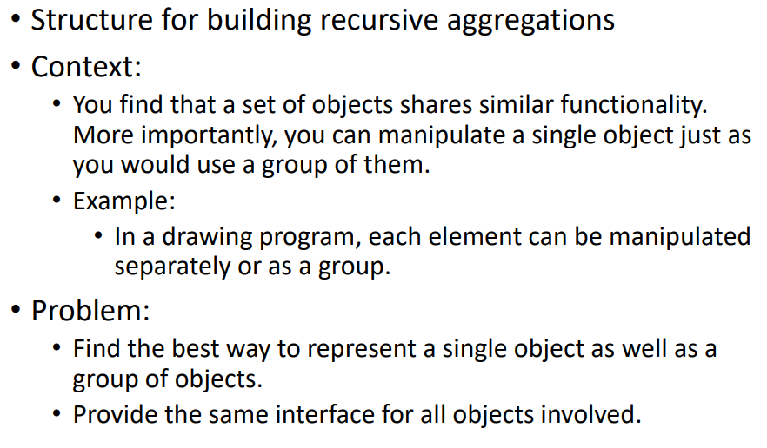
Composite Pattern

Slide 8
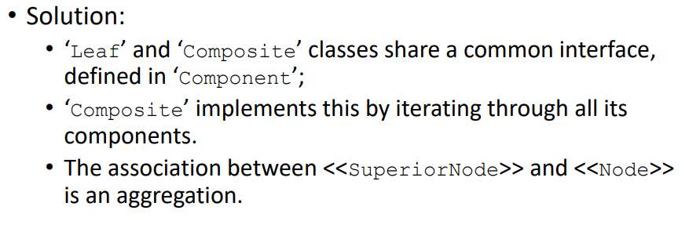
Composite Pattern

Slide 9
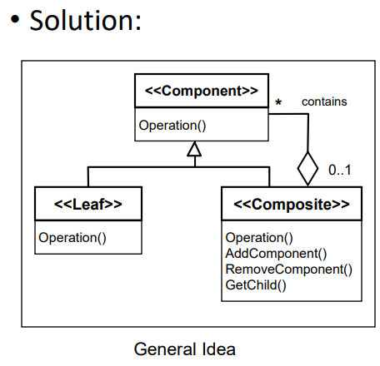
Composite Pattern

Slide 10
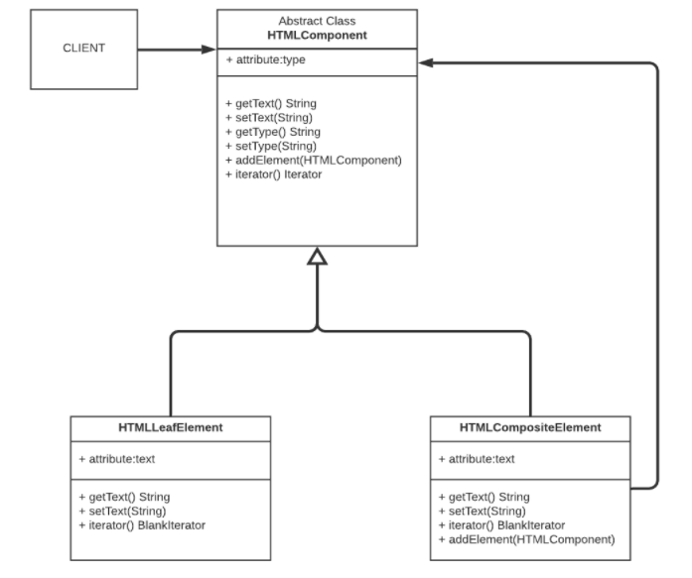

Slide 11
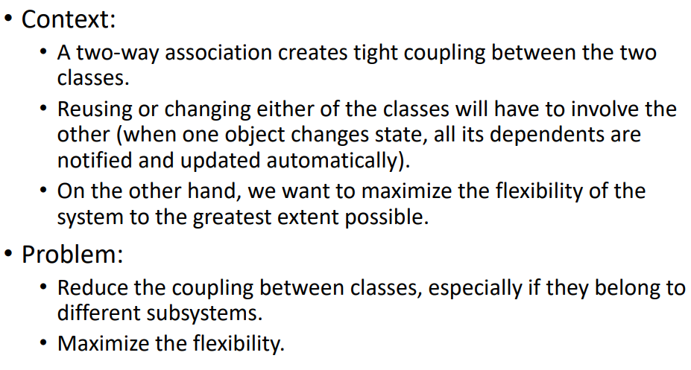
Observer Pattern

Slide 12
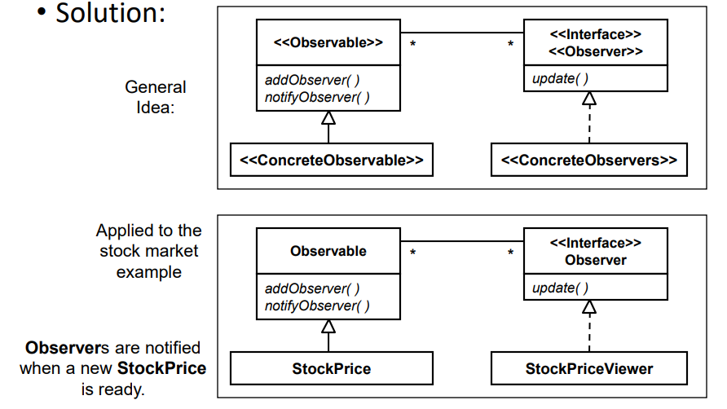
Observer Pattern

Slide 13
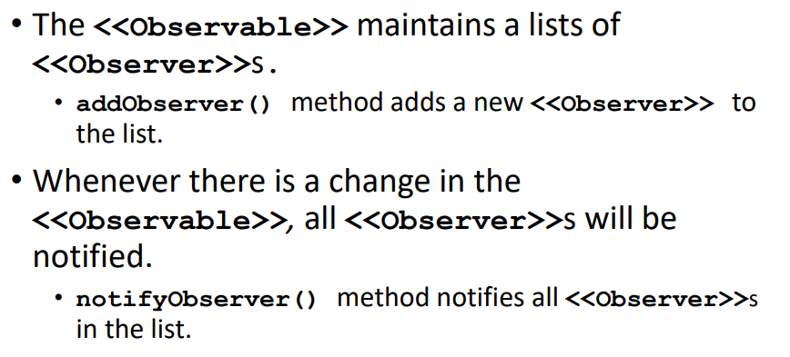
Observer Pattern

Slide 14


